Slide 1

Computer Graphics
Dr. Lucy J. Gudino
Computer Science & Information Systems Group
Birla Institute of Technology & Science, Pilani, Goa Campus

Slide 2
First comes thought; then organization of that thought, into ideas and plans; then transformation of those plans into reality. The beginning, as you will observe, is in your imagination.
Napoleon Hill

Slide 3
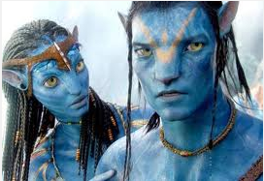


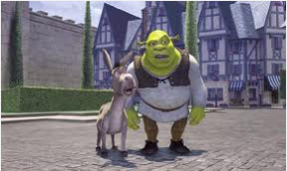
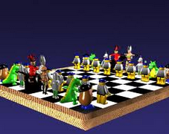

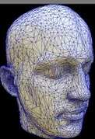


Slide 4

Let us transform it to reality

Slide 5



Slide 6
2-D Transformations

Slide 7
Introduction
What is transformations?
  The geometrical changes of an object from a current state to modified state.
  Operations are applied to the geometric description of an object to change its position, orientation, or size are called geometric transformations.
Why the transformations is needed?
  To manipulate the initially created object and to display the modified object without having to redraw it.

Slide 8
Contd…
Why use transformations?(contd..)
  Position objects in a scene (modeling)
  Change the shape of objects
  Create multiple copies of objects
  Projection for virtual cameras
  Animations

Slide 9
Contd…
2 ways
  Object Transformation
    Alter the coordinates descriptions an object
    Translation, rotation, scaling etc.
    Coordinate system unchanged
  Coordinate transformation
    Produce a different coordinate system

Slide 10
Coordinate System
Cartesian Coordinate System:
0,0
y
x
y
x
0,0

Slide 11
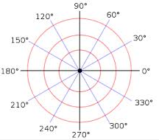
Coordinate System…
Polar Coordinate System: Position is specified using
  radial distance from the origin
  angular displacement from the horizontal
r
θ

Slide 12
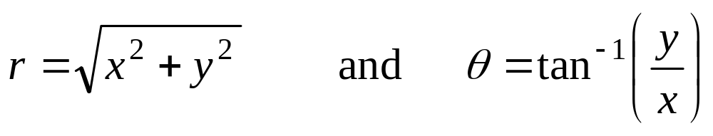
Polar - Cartesian
Polar to Cartesian:
x = r cos θ and y = r sin θ
Cartesian to Polar:

Slide 13
2D Transformation
Given a 2D object, transformation is to change the object’s
  Position (translation)
  Size (scaling)
  Orientation (rotation)
  Shapes (shear)

Slide 14

Translation

Slide 15

Translation

Slide 16

Translation

Slide 17
Rotation

Slide 18
Reflection

Slide 19


Reflection

Slide 20

Reflection

Slide 21
Matrix Representation
Advantages
  More convenient organization of data.
  More efficient processing
  Enable the combination of various concatenations

Slide 22
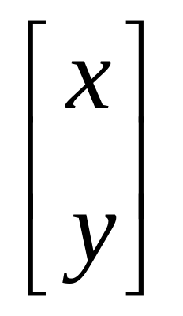
Matrix Representation of Point
2x1 matrix:

Slide 23
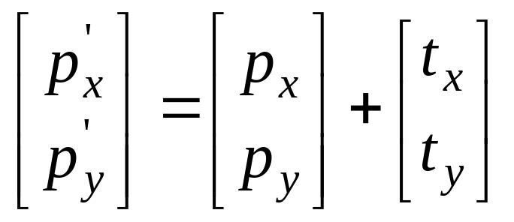
Translation
A translation moves all points in an object along the same straight-line path to new positions.
The path is represented by a vector, called the translation or shift vector.
We can write the components:
p'_{x} = p_{x} + t_{x}
p'_{y} = p_{y} + t_{y}
or in matrix form:
P' = P + T
?
t_{y}
=4
t_{x}
= 6
(2, 2)

Slide 24
Translation
How to translate an object with multiple vertices?
Translate individual
vertices

Slide 25
Scaling
Changing the size of an object is called a scale.
Scaling a coordinate means multiplying each of its components by a scalar
  Uniform scaling means scalar is the same for all components
  Non-uniform scaling: different scalars per component

Slide 26

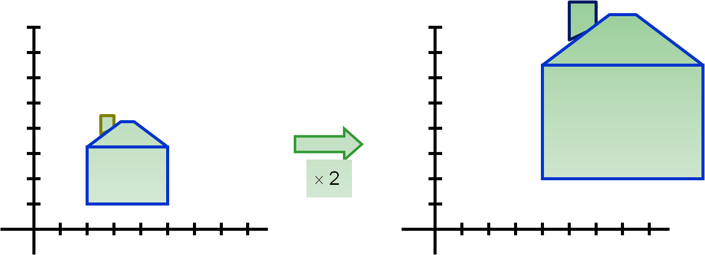
Uniform scaling

Slide 27
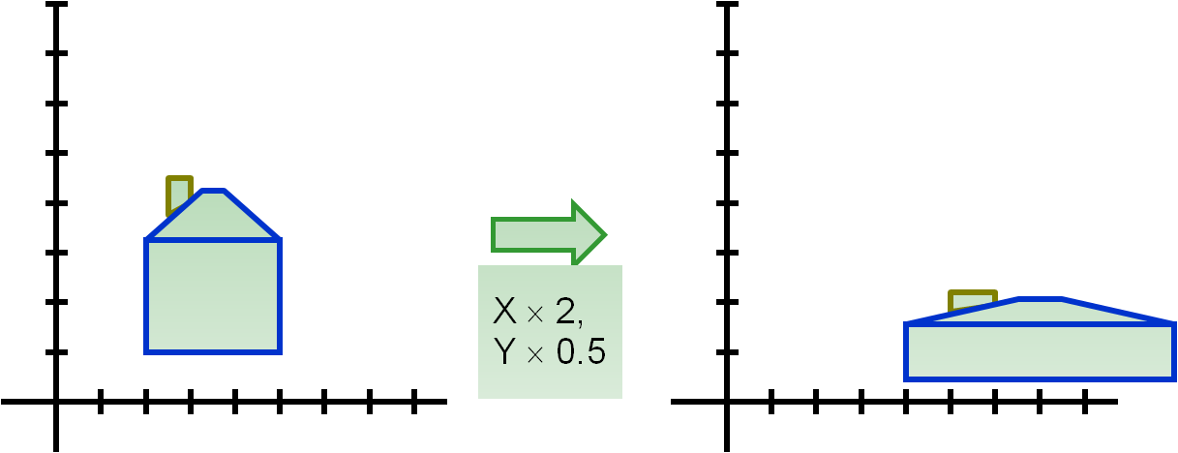
Non-uniform scaling
Differential scaling

Slide 28
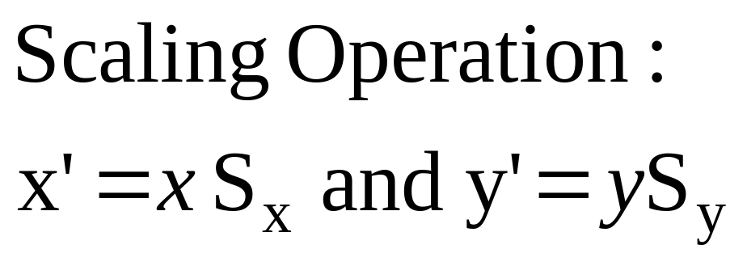
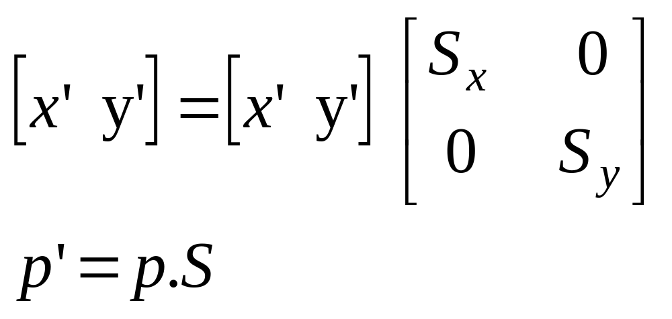
Scaling – Matrix representation

Slide 29
Problem
Scale the polygon with coordinates A(2,5), B(7,10) and C(10,2) by two units in x direction and two units in y direction

Slide 30
Rotation
A 2D rotation of an object is obtained by repositioning the object along a circular path in the xy plane.
To generate a rotation, we specify a rotation angle theeta and the position of the point about which the object is to be rotated
Default rotation center: Origin (0,0)

Slide 31
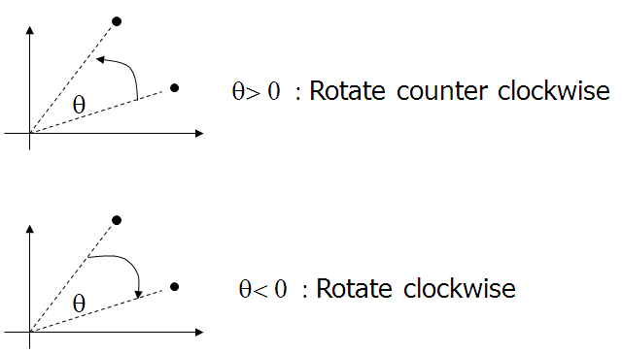
Rotation

Slide 32
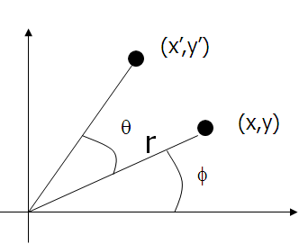
Contd…
(x,y) → Rotate about the origin by θ
→ (x’, y’)
How to compute (x’, y’)?
The original coordinates of the point in polar coordinates are given by
x = r cos (φ) y = r sin (φ)

Slide 33
Contd…
x’ = r cos (φ + θ) y’ = r sin (φ + θ)
x’ = r cos (φ + θ)
= r cos(φ) cos(θ) – r sin(φ) sin(θ)
= x cos(θ) – y sin(θ)
y’ = r sin (φ + θ)
= r sin(φ) cos(θ) + r cos(φ)sin(θ)
= y cos(θ) + x sin(θ)

Slide 34
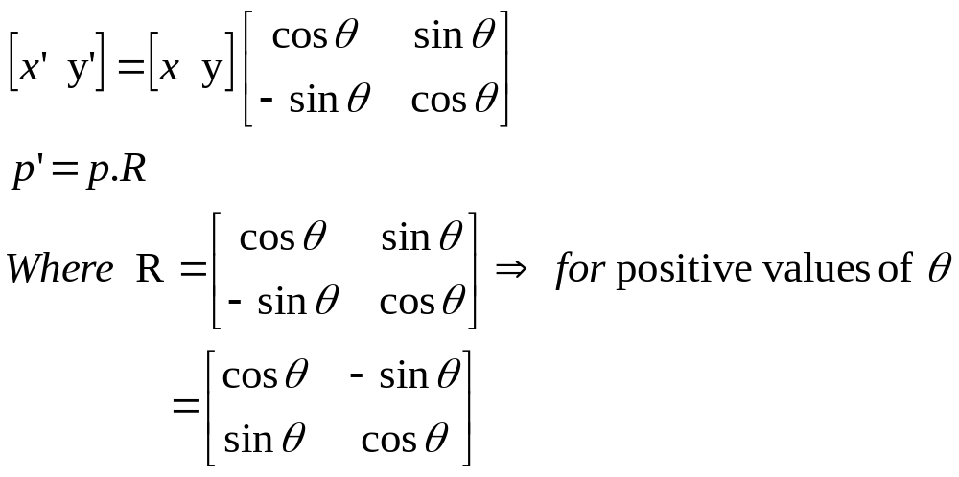
Matrix Form…
x’ = x cos(θ) – y sin(θ)
y’ = x sin(θ) + y cos(θ)

Slide 35
Problem
A point (4,3) is rotated counterclockwise by an angle of 45 degrees. Find the rotation matrix and resultant point.

Slide 36
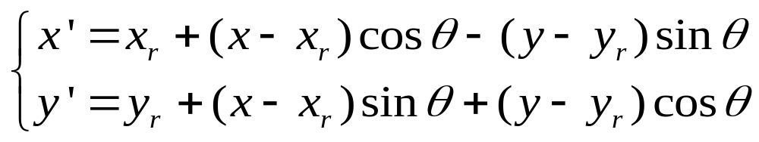
Think!!!!
If the rotation point is an arbitrary pivot position (x_{r},y_{r}) , can you give the correct rotation expression?

Slide 37
Think!!!!
How to rotate a line segment or a polygon?
Rotate individual
Vertices
θ

Slide 38
Summary
Transformations
  P’ = T + P (Translation)
  P’ = S . P (Scaling)
  P’ = R . P (Rotation )
Translation is treated differently (as an addition) from scaling and rotation (as multiplication.
Better to treat all three transformations in a consistent way, so that they can be combined easily

Slide 39
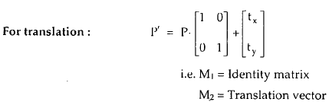
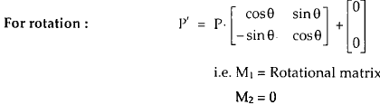
General matrix for basic transformation

Slide 40
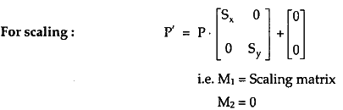
General matrix for basic transformation

Slide 41
Contd…
How to handle sequence of transformations?
2 approaches:
  Calculate one step at a time
  Combine sequence of transformations in to one
Approach 2 is efficient but needs to eliminate matrix addition associated with translation
Solution: Represent Matrix M1 as 3x3 instead of 2x2 (introduce dummy coordinate)

Slide 42
Contd…
represent 2 x2 matrix by 3x3 matrix
  points are represented by 3 numbers instead of two
  coordinate system known as homogeneous coordinate system
    It allows as to express all transformation equations as matrix multiplication

Slide 43
3x3 matrix representation
We can perform all transformations using matrix/vector multiplications
This allows us to pre-multiply all the matrices together
The point (x,y) needs to be represented as
(x,y,1) -> this is called Homogeneous
coordinates!

Slide 44
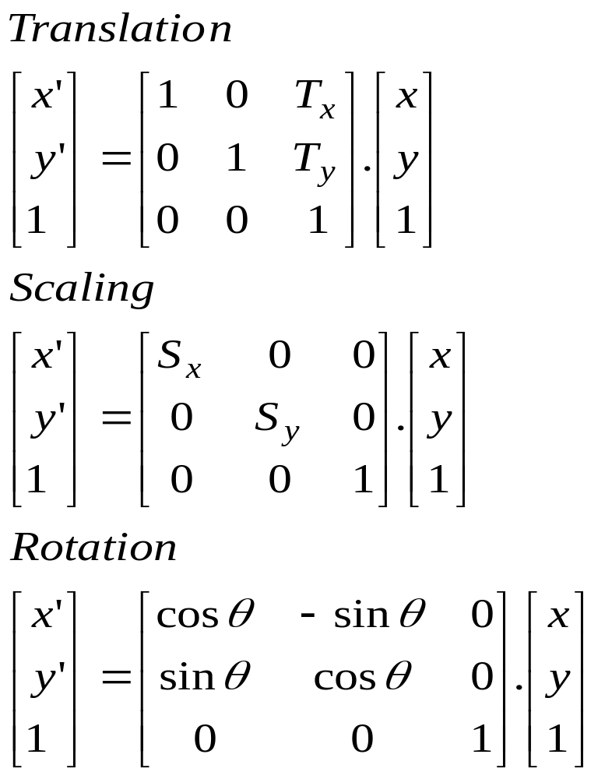
Contd…

Slide 45
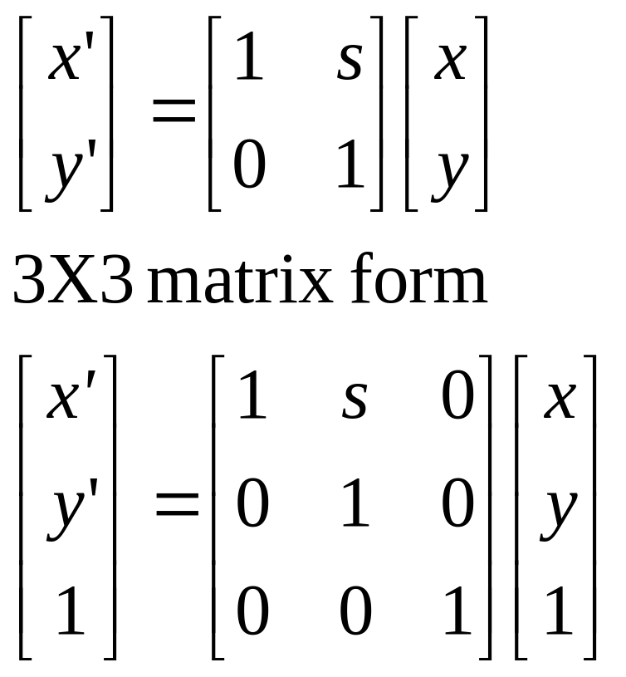
Shearing in x
Horizontal displacement proportional to vertical position

Slide 46
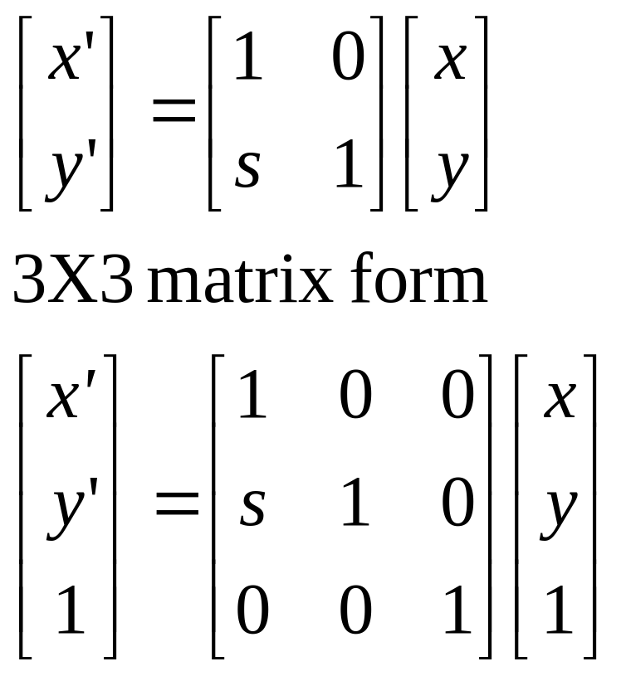
Shearing in y

